Slide 1
HIGHLY ACCURATE CNN CLASSIFIER FOR RICE LEAF DISEASE DETECTION AND CLASSIFICATION
PRESENTED BY: SUPERVISOR:

Slide 2
LIST OF CONTENTS
INTRODUCTION
LITERATURE SURVEY
PROBLEM STATEMENT
OBJECTIVES
ABSTRACT
PROPOSED SYSTEM BLOCK DIAGRAM
MODULES
DESCRIPTION OF THE PROPOSED SYSTEM
ADVANTAGES
APPLICATIONS
CONCLUSION
REFERENCES

Slide 3
INTRODUCTION
Plant diseases and pests detection is a very important research content in the field of machine vision.
It is a technology that uses machine vision equipment to acquire images to judge whether there are diseases and pests in the collected plant images.
At present, machine vision-based plant diseases and pests detection equipment has been initially applied in agriculture.
How to use deep learning technology to study plant diseases has become a research issue of great concern to researchers.
This project helps to detect the disease that makes the plant to be affected.
Moreover, accurate classification of disease from plant is obtained with the proposed technique.

Slide 4
LITERATURE SURVEY
SI NO | TITLE AND AUTHOR | METHODOLOGY USED | ADVANTAGES | DRAWBACKS
1. | Identification of Fruit Tree Pests With Deep Learning on Embedded Drone to Achieve Accurate Pesticide Spraying, & Ching-ju chen et al [2021] IEEE. | A detecting drone is employed to photograph the pest and uses a Tiny-YOLOv3 neural network model built on an embedded system NVIDIA Jetson TX2 to recognize T. papillosa in the orchard to determine the position of the pests in real time. | Enables farmers to understand the pest distribution and take appropriate precautions in real-time. The agricultural drone sprays pesticides only where needed, which reduces pesticide use. | However, using environmental sensors, it is possible to predict whether climatic factors, influence the occurrence of pests, and to help farmers take timely preventive actions.
2. | A New Path to Predict Susceptibility of Cocoa Pod Against Carmenta foraseminis (Busck) Eichlin Using a Mathematical Model’ &Raquel M. Sotomayor-Parian et al [2018] IEEE. | This paper determines the evaluation of the risk or susceptibility of infestation of the cocoa pods Richards Model. | Promotes the optimization control strategies. Prompts the intervention against this phytopathogen, avoiding the quality of the overall harvest at risk. | However, there is a great challenge related to the lack of data systematization, such as measurements of cocoa fruits under the same criteria..

Slide 5
CONTINUED…
SI NO | TITLE AND AUTHOR | METHODOLOGY USED | ADVANTAGES | DRAWBACKS
3. | N Krishnamoorthy et al, “Rice Leaf Disease Detection Via Deep Neural Networks With Transfer Learning For Early Identification ” et al [2021] IEEE. | A convolutional neural network models such as VGG-16, ResNet50 and InceptionV3 is used | ResNet50 and InceptionV3 have attained an optimized accuracy of 93.41% and 95.41% in attaing plant leaf disease classification. | Nature inspired algorithms for selecting the best hyper parameters automatically for fine-tuning the CNN is not utilized.
4. | Prabira Kumar Sethy et al, “Deep feature based rice leaf disease identification using support vector machine” et al [2020] IEEE. | CNN classification models is used | The deep feature of ResNet50 plus SVM performs better with F1 score of 0.9838. | Misclassification occurs due to the similarity of color.

Slide 6
PROBLEM STATEMENT
The following are the major issues while designing the proposed system.
Limited number of training samples are available and accuracy of classification is not high.
The technique’s performance on the boundaries between different regions is relatively poor.
The algorithm complexity of training and testing on the datasets is high.

Slide 7
OBJECTIVES
To reduce the noise in the input image using Median filter.
To extract the desired features using GLCM (Gray Level Co-occurrence Matrix).
To increase the plant disease classification accuracy using CNN classifier.

Slide 8
ABSTRACT
This project proposes a rice leaf disease classification using novel image processing approach.
In this work, the noise in the input image is removed using Median filter.
Thus, the enhanced image is then segmented using Fuzzy c-means segmentation.
By using GLCM (Gray Level Co-occurrence matrix), the desired features are extracted. The optimal features are selected by the Fuzzy technique.
In order to classify the features, Convolutional Neural Network (CNN ) classifier is employed.
This project is implemented with Python.

Slide 9
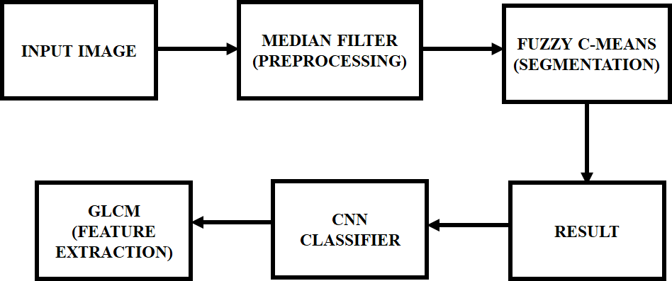
PROPOSED SYSTEM BLOCK DIAGRAM

Slide 10
DESCRIPTION
The input image is pre-processed using Median filter, which is used to eliminate the noises for preserving the edges of the images.
After pre-processing the images, the fuzzy c-means segmentation algorithm is used to segment the images.
This method efficiently segments the region of an image into several samples.
GLCM (Gray Level Co-occurrence matrix) is utilized as the next step after image segmentation.
By using this GLCM, specific features from the segmented samples are extracted. The optimal features are selected using Fuzzy technique.
Finally, Convolutional Neural network (CNN) classifier is used to classify the features that verifies whether the rice leaf gets affected by disease or not.

Slide 11
ADVANTAGES
Time consumption is low.
Accuracy of the results is high.
Computational complexity of the algorithm is low.

Slide 12
APPLICATIONS
Image Polishing and restoration.
Small Lesion Detection
Image Segmentation
Object Detection

Slide 13
REFERENCES
Ching-Ju Chen;Ya-Yu Huang;Yuan-Shuo Li;Ying-Cheng Chen;Chuan-Yu Chang;Yueh-Min Huang, Year:2021, “Identification of Fruit Tree Pests With Deep Learning on Embedded Drone to Achieve Accurate Pesticide Spraying”, IEEE Access, vol.9, pp. 21986 – 21997.
R. M. Sotomayor-Parian and M. M. Soto-Cordova, Year:2018, "A New Path to Predict Succeptibility of Cocoa Pod Against Carmenta foraseminis (Busck) Eichlin Using a Mathematical Model," 2018 Congreso Argentino de Ciencias de la Informática y Desarrollos de Investigación (CACIDI), pp. 1-4.
Krishnamoorthy, V.R Loga Parameswari, Year 2021, "Rice Leaf Disease Detection Via Deep Neural Networks with Transfer Learning for Early Identification”, Turkish Journal of Physiotherapy and Rehabilitation, vol.32, no.2.
Sethy, P.K.; Barpanda, N.K.; Rath, A.K.; Behera, S.K. , Year 2020, “Deep feature based rice leaf disease identification using support vector machine”, Comput. Electron. Agric, volume. 175, pp. 105527.

Slide 14


